Slide 1
Anatomy Vocab,
Hand Bones,
Teeth,
Skull Bones &
Spine Bones

Slide 3
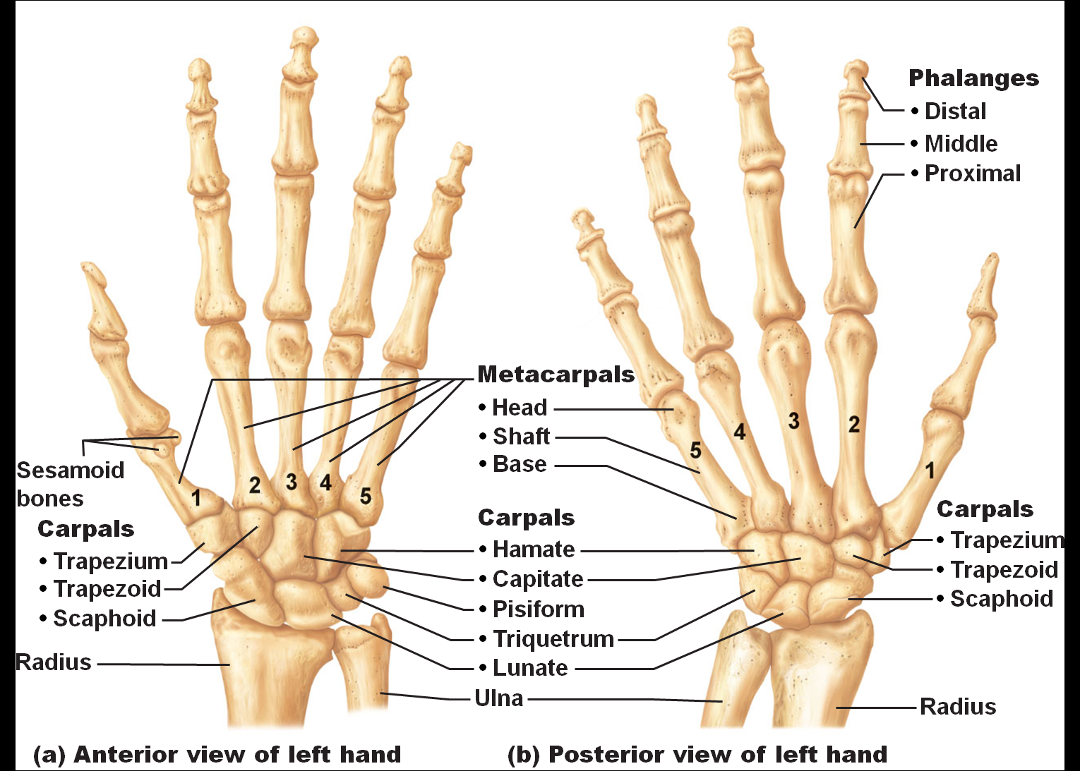

Slide 6
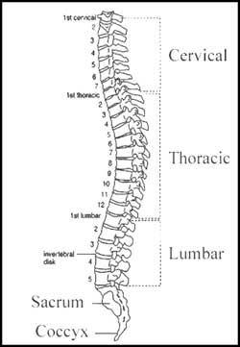

Slide 7
# Ribs = 1-12 11 & 12 = Floating Ribs

Slide 8
Muscles

Slide 9
